Slide 1
Cool K-6 Collaborations
Shannon Minner, MNP Librarian
shannon.minner@cityschools.net
Sarah Svarda, Discovery School Librarian
sarah.svarda@cityschools.net
Murfreesboro, TN

Slide 2
Welcome
Please take a minute to answer our questions on the chart paper.
In terms of collaboration
- What has worked for you?
- What hasn’t worked for you?

Slide 3
What Has Worked For Us
Telling teachers about the lesson and what we are teaching ahead of time.
What we expect for the teachers to do during the lesson.
Having a collaboration form
Finding out what the teachers are teaching ahead of time.
Getting principal support so that they give you the time to heave an open schedule to collaborate.
Be open-minded about what people bring to you. They may have different ideas that you haven’t thought of.

Slide 4
Mistakes We Have Made
Not making sure the teachers stay with you while their class is working.
Collaborating only with the teachers you feel comfortable with.
Getting our hopes up that every project will be wonderful.
Taking to much of the responsibility ourselves
- Take an idea to the teacher.
- Get them excited.
- Get them involved in the planning process.

Slide 5
How to Collaborate On A Fixed Schedule
Collect information on what the classroom teachers are teaching.
Keep up with subjects that they are teaching.
You will be responsible for making your own lessons that correlate.

Slide 6
How to Collaborate On A Flexible Schedule
Starting is hard but teachers will relax and realize that they can use the library for their important projects.
You don’t have to be restrictive about your time.
Post your schedule outside the room. Let teachers schedule a time and topic.

Slide 7
How to Collaborate On A Combination Schedule
Find slots of time that work for you and the teacher.
This might be hard because times that may be good for them may not be good for you.
Occasionally remind teachers that you have open times.
If you have a schedule of topics take the initiative to approach a teacher with an idea.

Slide 8
How to Get Started
Target a teacher you have a good relationship with.
Work with them to come up with a topic.
Do an outstanding job!
Ask the teacher to tell the other teachers in their grade level about the project.
That teacher can make a short speech at a faculty meeting about their experience.
Good news travels fast.

Slide 9
Collaborating With Other Special Area Teachers
“T is for Tennessee” with Music Teacher
Sing along
Holiday Events
Researching Artists
Fancy Nancy Tea Party
Rap Battle of the Books
- Good for ½ Days

Slide 10
Tips
Set a project and keep it for a certain grade level so you are not repeating it.
Keep the collaboration meeting with a teacher simple. Come prepared!
Contact them via e-mail if you feel like they will read it.
Talk to other librarians in your school system and see what has worked.

Slide 11
More Tips
Keep a running collaboration form so that you know what they are doing throughout the year.
Classes don’t always have to come to you, you can go to them.
Keep a notebook of master photocopies and collaborations.
Make sure your principal is on board. Invite them to come be a part.
Work with the schedule you have.

Slide 12
Even More Tips
Keep a record of your projects as proof that you are filling up your time.
- You could lose your time if your principal doesn’t
think you are using it.
Focus on a grade level each year and print off their reading or science standards. Highlight the ones you are teaching and maybe jot down a lesson idea, note, or date you taught the lesson.

Slide 13
2 Successful Collaborations
Who Would Win
Wonder Bubbles

Slide 14
Project Ideas
Please browse the room and check-out some projects we’ve done.
There will be a description posted
We can answer any questions you have.
Pick up a packet with the descriptions as you leave.
And don’t forget to…

Slide 15
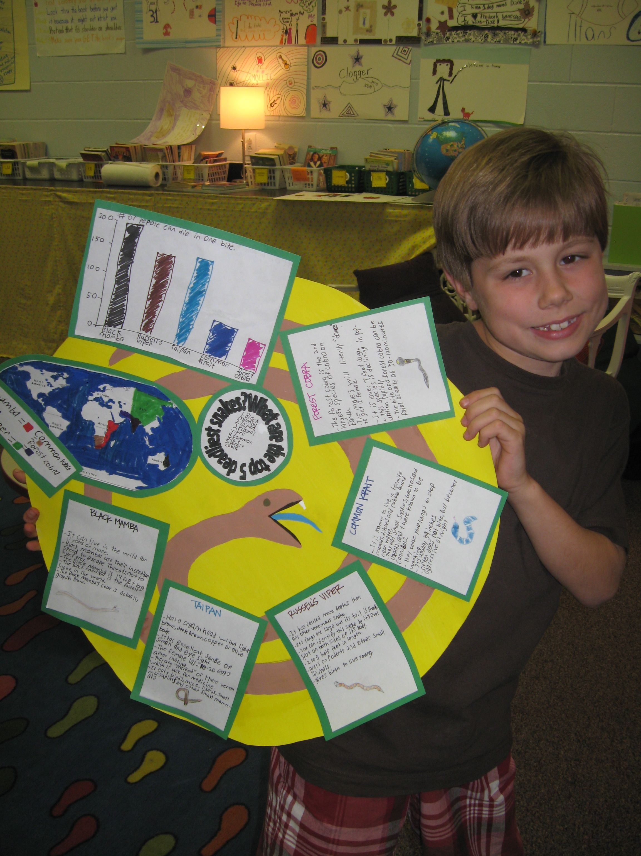

Slide 16
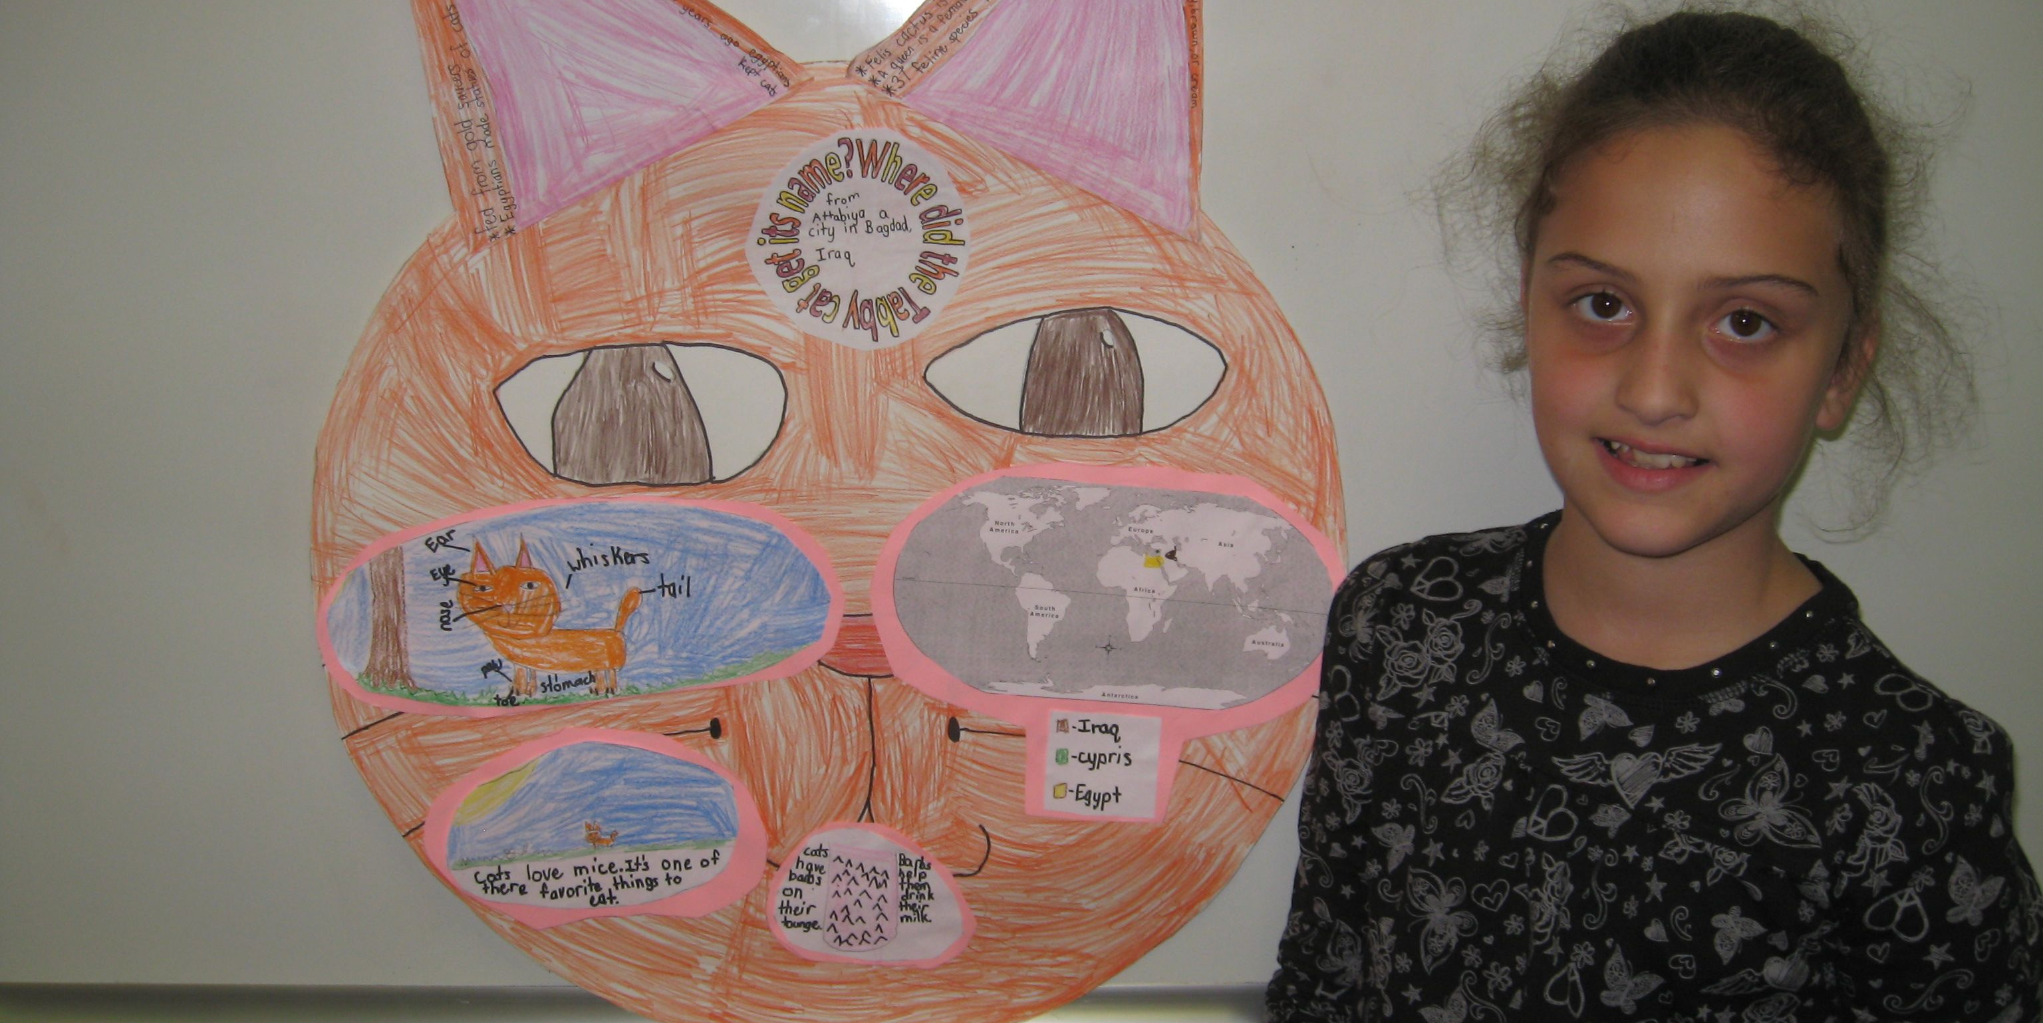

Slide 17
Fill Out An Exit Card
Take a moment to tell us about a successful collaborative project you have done.
Fill out the form (or a scrap sheet of paper) then turn it in.
We will compile a list and e-mail it to everyone.

